Slide 1

Multi-threaded Stereo Vision Positioning
ECE1747H Project Presentation
Presented by
Shiyuan Wu, Andre Lo, Xianglu Shi
December 14th, 2016

Slide 2
Introduction
The problem of real-time 3D positioning of object is an important and hot topic which is applicable to many areas, such as robotics, virtual reality
The project presents a 3D positioning with single thread and multi-thread implementation by using dual camera
Stereo Vision, as one typical technology, used to solve this problem

Slide 3
Stereo Vision
Wide research topic in computer vision
Stereo Vision system is a technique aimed at inferring depth from two cameras
It take two images of a scene from different viewpoints
Usually referred to as left and right images
Left and right images are slightly different
Disparity is displacement of corresponding point from one image to the other
From the disparity, we can calculate depth

Slide 4
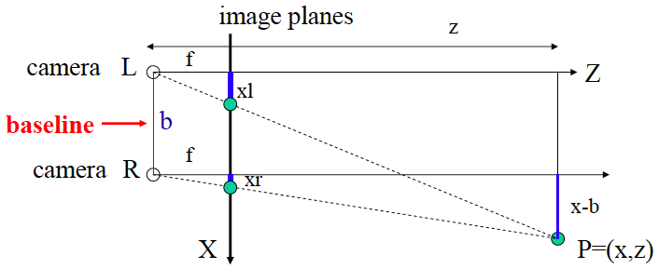
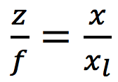
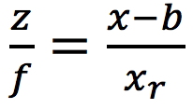
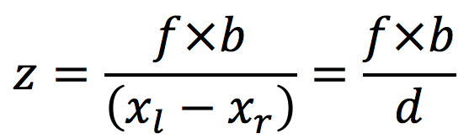
Stereo Vision
Simple model: Optic axes of 2 cameras are parallel
From similar triangles:
Depth z is inversely proportional to disparity d (d=xl-xr)
This method of determining depth z from disparity d is called triangulation

Slide 5
Challenges
Need to know focal length f, and baseline b
Use prior knowledge
Need to detect and segment object
Color based methods
OpenCV
BGR->HSV
Find the optimum HSV ranges for an object
Need to track moving object
OpenCV
Find corresponding points (xl, yl) (xr, yr) for each camera image

Slide 6
Implementation
Platform:
Windows 10 64 bit
Intel® Core™ i5-6200U @2.30GHz
8GB RAM
Camera:
Blackberry Classic front Camera
2MP 2.31mm fixed focal length
OpenCV:
OpenCV 3.1.0

Slide 7
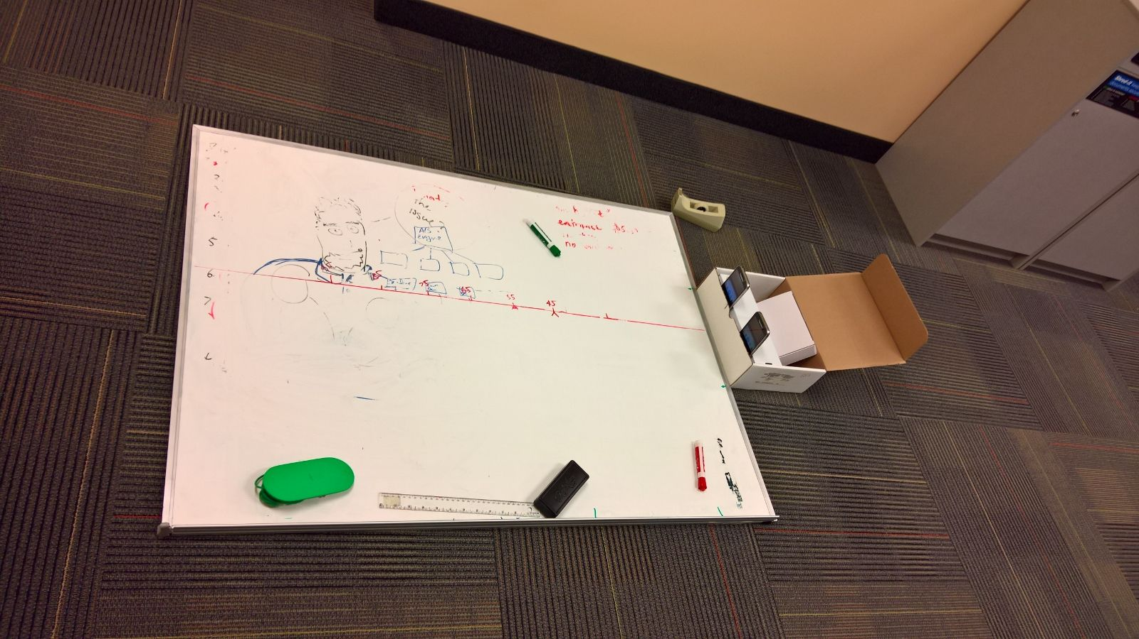
Platform Setup

Slide 8
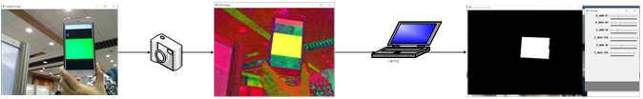
Basic OpenCV operation(Related Work)

Slide 9
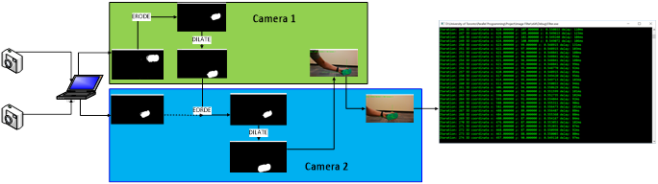
Single Thread Implementation

Slide 10
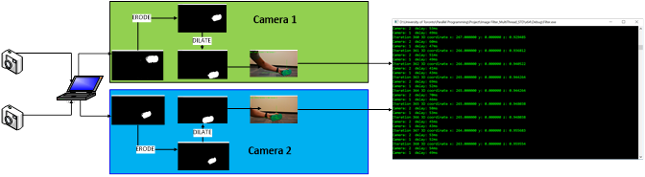
Parallel Implementation: DWORD WINAPI
Parallel both camera image processing

Slide 11
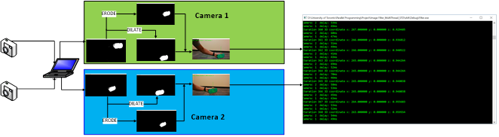
Parallel Implementation: STD:THREAD
Further parallelize Image Enhancement: Erode and Dilate

Slide 12
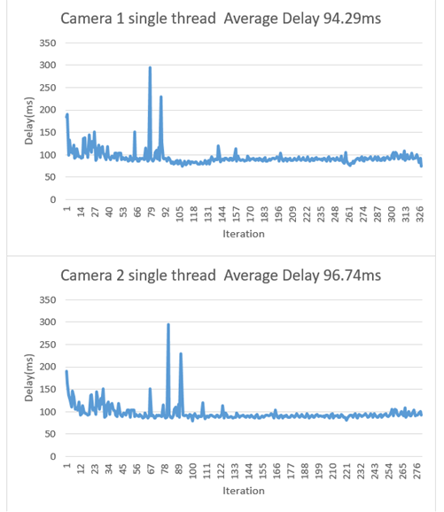
Experimental Result - Single Thread

Slide 13
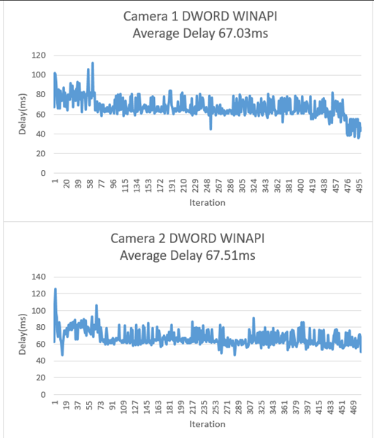
Experimental Result – DWORD WINAPI

Slide 14
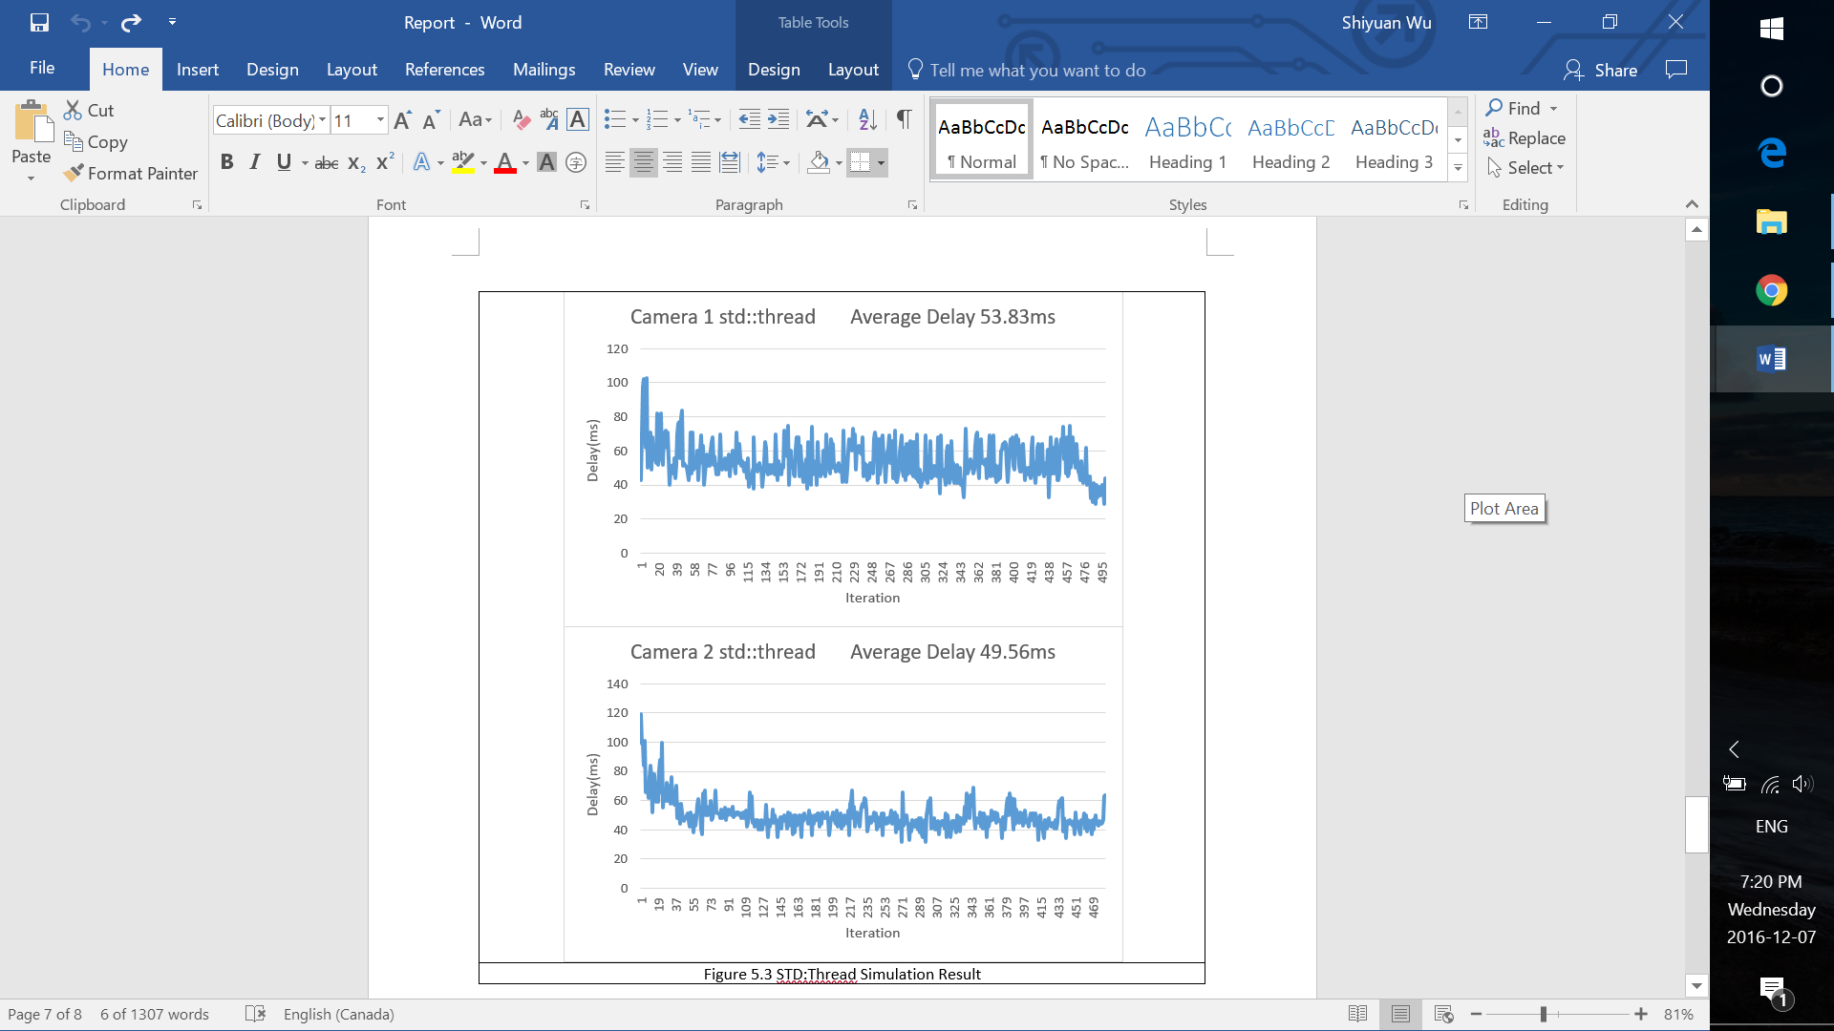
Experimental Result – STD::THREAD

Slide 15
Conclusions
We parallelized the calls to OpenCV for image capture and processing
1.4x speedup with 2 threads calling OpenCV (one per camera) and 1 thread doing 3D positioning
1.8x speedup with 4 threads calling OpenCV (one per camera, per operation) and 1 thread doing 3D positioning
On a 2-core Intel CPU, we want a theoretical speedup of 2x
1.8x speedup with 5 threads shows that the nature of stereo positioning workload creates an imbalance between the threads
However, it was easier and more effective to spawn another thread instead of trying to alter the algorithm to balance the workloads

Slide 16
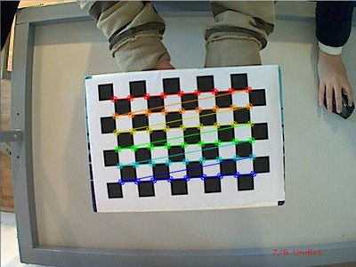
Future work
Camera Calibration
Again, capture camera feed with OpenCV, but additionally parallelize calculation of error correction matrix
Error correction derived from capture set of test images
Compensate for unique lens distortion of stereo camera hardware

Slide 17
Future work
Live camera feed
Replace video file input with camera feed
For real-time applications such as robotics, automotive
Introduces additional workload that can be parallelized
Introduces producer-consumer problem between camera feed and image processing
Thread pool instead of spawning sub-threads
Erode and dilate sub-threads are created/ destroyed every frame
Consider using a thread pool and explore if savings can be had. Depends thread creation and OpenCV performance

Slide 18
Thank You
Questions?

